Slide 1
Sentiment Analysis Based on Amazon Review
STOR 565 Project Presentation
Presenter: Yi Ding, Pinqiao Wang
11.30.2022

Slide 2
Agenda
Overview
Data Description & Processing
ML & DL Methods
Conclusion

Slide 3
Overview

Slide 4
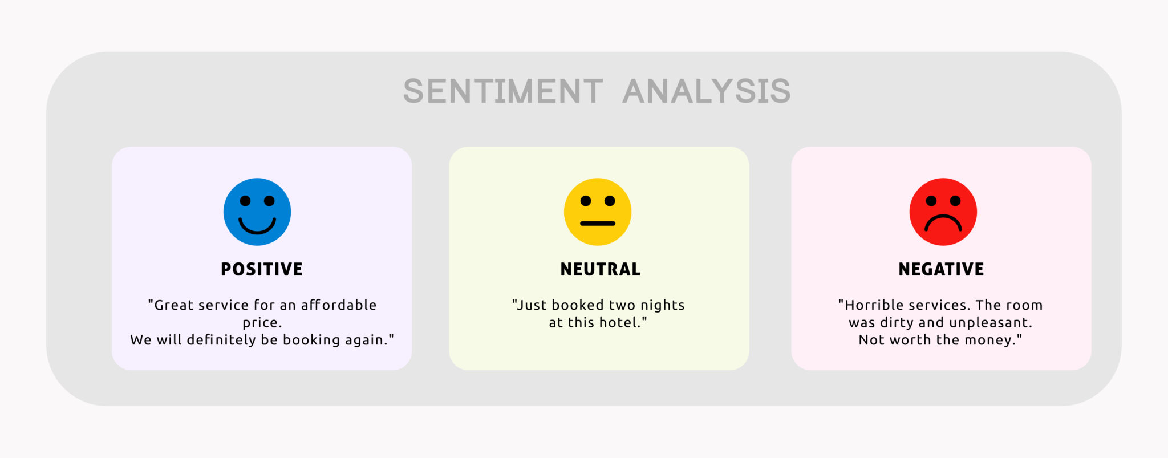
Overview
What is sentiment analysis?
  First known as the General Inquirer, examining patient’s mental status based on their verbal behavior (Stone et al, 1966)
  systematically identify, extract, quantify, and subjective information using Natural Language Processing
  Widely applied to reviews, survey responses, and social media
Application: market research, product analysis, etc

Slide 5
Overview
Simple cases:
  Coronet has the best lines of all day cruisers.
  I dislike old cabin cruiser
  Pastel-colored 1980s day cruisers from Florida are ugly
Possible challenges:
  Negation: I do not dislike cabin cruisers.
  Sarcasms: I'd really truly love going out in this weather!
  Negative term used in positive sense: The movie is surprising with plenty of unsettling plot twists.
  Qualified positive: I love my mobile but would not recommend it to any of my colleagues.
Impossible to have perfect classification, but we can try different techniques

Slide 6
Data Description

Slide 7
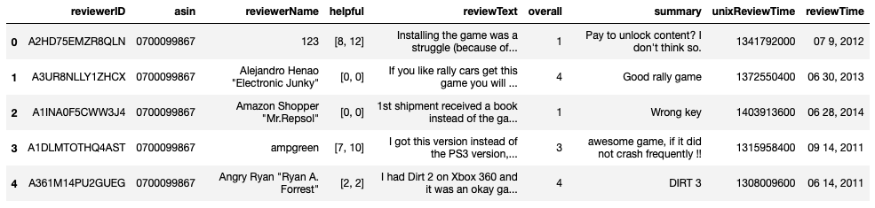
Data Description & Processing
Goal: to perform sentiment analysis on Amazon Review Dataset
  Containing product reviews and metadata from Amazon, including 142.8 million reviews spanning May 1996 - July 2014
  Will focus on “Video Games Dataset”
  231780 observations
  Use “summary” to predict positive or negative comments

Slide 8
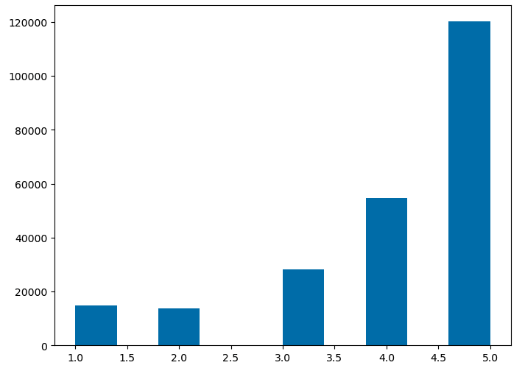
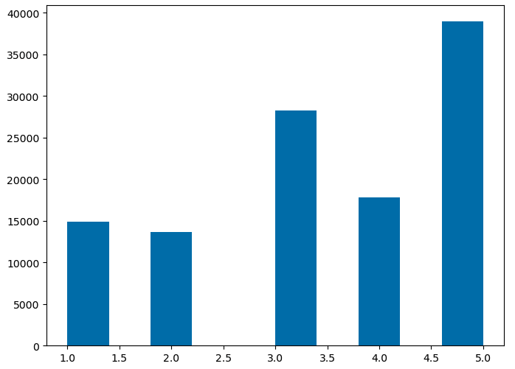
Data Description & Processing
We define reviews with rating <=3 as negative, >3 as positive
  Having 56791 negative reviews, 174989 positive reviews
Given the comments are overwhelmingly positive, we need to resample the data to make sure we have a relatively balanced classes of polarity
  Randomly sampled 56791 positive reviews so that # of positive review = # of negative review
Split the whole dataset into 80% training set and 20% test set

Slide 9
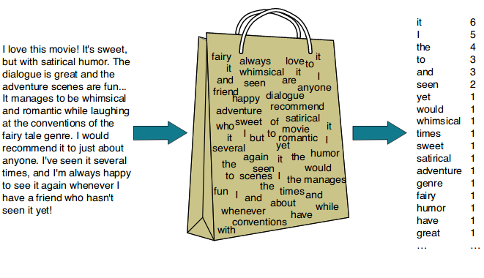
Data Description & Processing
Convert frequency of words appeared into matrix of numbers
Also known as “bag of words”
Achieved through Sci-kit learn package in Python
  Contain options of tokenization, removing stop words “a, the, of, etc” and words that appear in 50% of reviews
  Result: 90865x17406 sparse matrix (A lot of Calculation!)

Slide 10
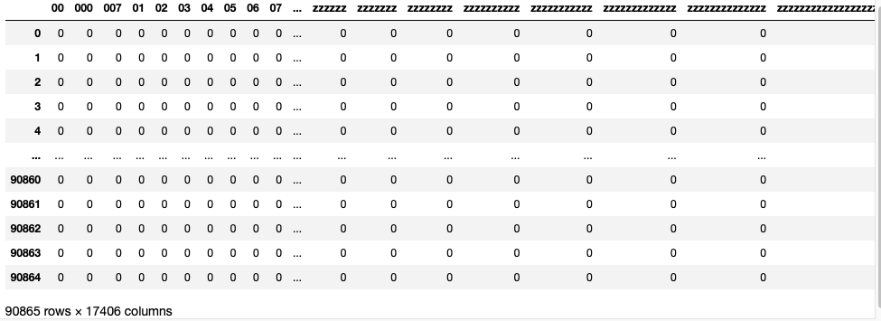
Data Description & Processing
90865 rows: 90865 observations in dataset
17406 columns: 17406 unique words appeared

Slide 11
ML&DL Techniques

Slide 12
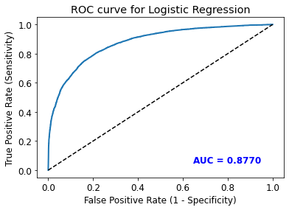
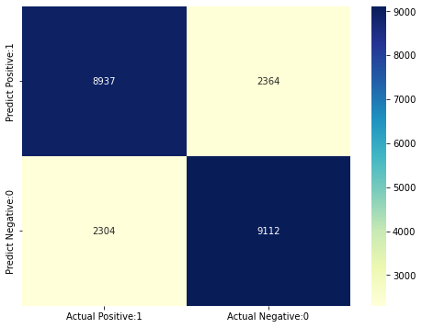
Machine Learning Techniques
Logistic Regression
Model Accuracy | Model Sensitivity | Model Specificity
0.7945 | 0.7950 | 0.7940
The confusion matrix shows 8937 + 9112 = 18049 correct predictions and 2364 + 2304 = 4668 incorrect predictions
Notes:
1. The logistic regression model accuracy score is 0.7945. So, the model does a very good job in sentimental analysis.
2. ROC AUC of our model approaches towards 1. So, we can conclude that our classifier does a good job in predicting.
3. Sensitivity and Specificity rate are similar with accuracy rate, data is balanced and low false positive rate.

Slide 13
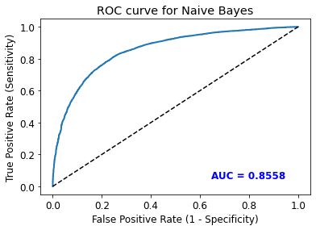
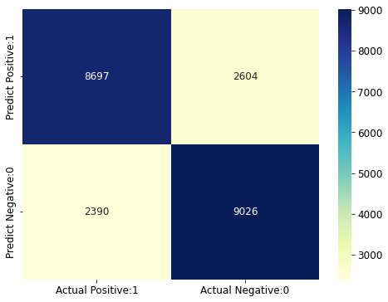
Machine Learning Techniques
Model Accuracy | Model Sensitivity | Model Specificity
0.7802 | 0.7844 | 0.7761
Naïve Bayes
The confusion matrix shows 8697 + 9026 = 17723 correct predictions and 2604 + 2390 = 4994 incorrect predictions

Slide 14
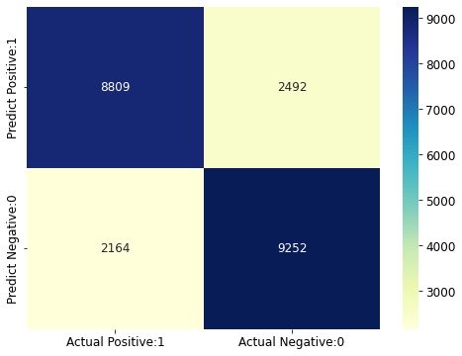

Machine Learning Techniques
The Best: SVM with RBF kernel
Model Accuracy | Model Sensitivity | Model Specificity
0.8109 | 0.8143 | 0.8077
SVM
  Kernel: RBF
  Cost = 1
Linear SVM
Gaussian Radial Basis (RBF) SVM
Improve
The confusion matrix shows 8809 + 9252 = 18061 correct predictions and 2492 + 2164 = 4656 incorrect predictions
The confusion matrix shows 9075 + 9347 = 18422 correct predictions and 2226 + 2069 = 4295 incorrect predictions

Slide 15
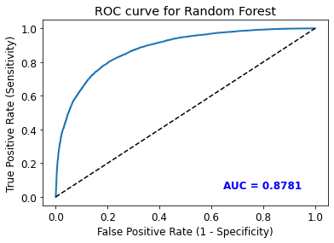
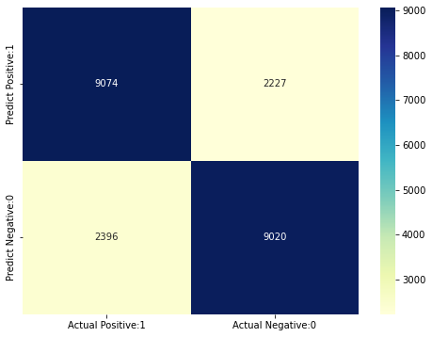
Machine Learning Techniques
Model Accuracy | Model Sensitivity | Model Specificity
0.7965 | 0.7911 | 0.8020
Random Forest Classifier
  Number predictors per tree: 1000
The confusion matrix shows 9074 + 9020 = 18094 correct predictions and 2227 + 2396 = 4643 incorrect predictions
Notes:
1. The logistic regression model accuracy score is 0.7945. So, the model does a very good job in sentimental analysis.
2. ROC AUC of our model approaches towards 1. So, we can conclude that our classifier does a good job in predicting.
3. Sensitivity and Specificity rate are similar with accuracy rate, data is balanced and low false positive rate.

Slide 16
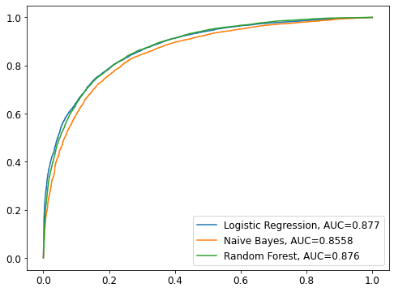
Machine Learning Techniques
ML Model Comparison
Aggregate ROC&AUC Curves
Methods Used | Model Accuracy | Model Sensitivity | Model Specificity
Logistic Regression | 0.7945 | 0.7950 | 0.7940
Naïve Bayes | 0.7802 | 0.7844 | 0.7761
RBF SVM | 0.8109 | 0.8143 | 0.8077
Random Forest | 0.7965 | 0.7911 | 0.8020

Slide 17
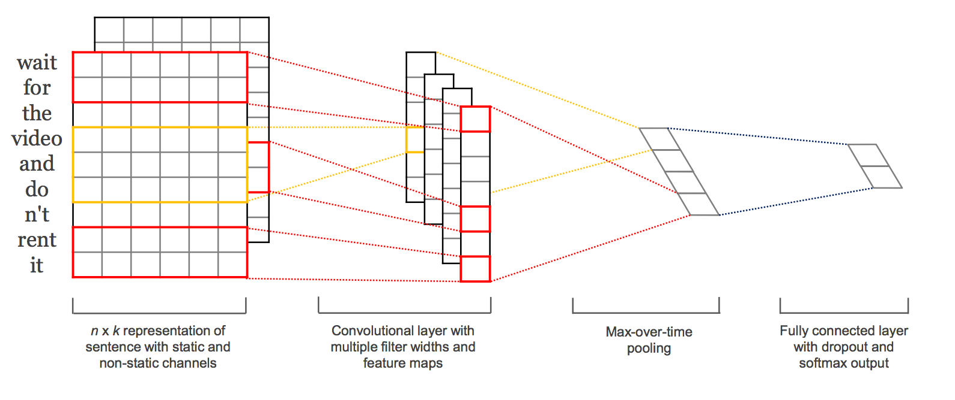
Deep Learning: Convolutional Neural Network (CNN)
Imitate the neurons inside brain; thus known as “neural network”
Pros: high accuracy; able to handle large data input
Cons: greater computational cost; lack of interpretability (black box)

Slide 18
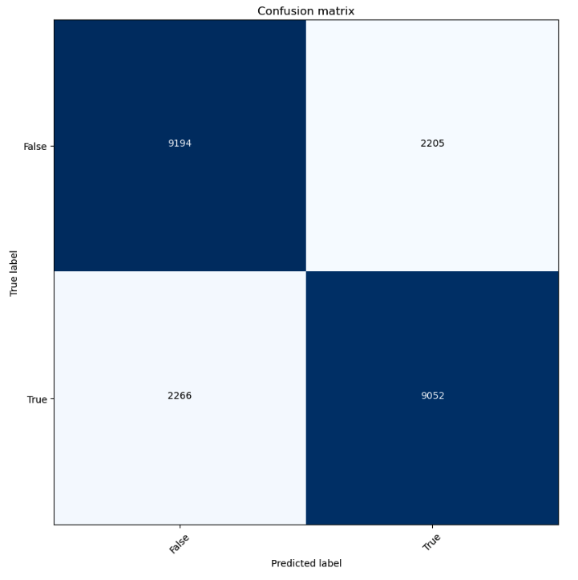
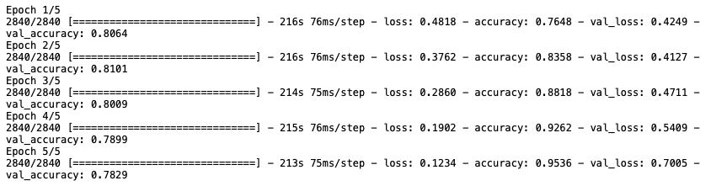
Deep Learning: Convolutional Neural Network (CNN)
Used TensorFlow to build neural network

Slide 19
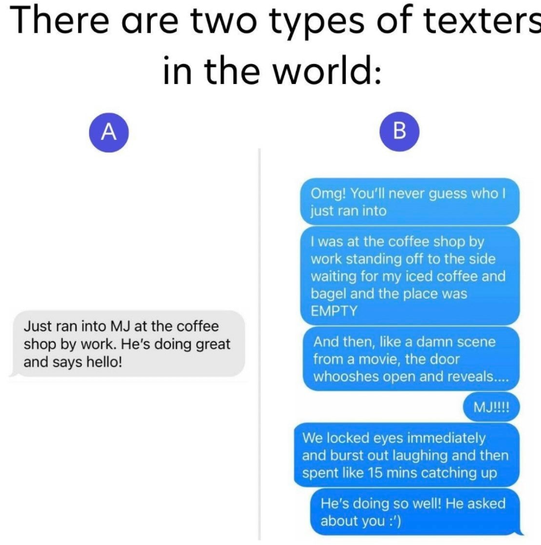
Deep Learning: Convoluted Neural Network (CNN)
In a lot of cases deep learning methods performs better on binary classification
Why is the result not as good as expected?
  Possibly due to the short text length in “summary”
  Overfitting happened and the 2nd epoch returns the lowest test error
    We hope there’re more “people” like A

Slide 20
Conclusion

Slide 21
Conclusion
Overall, the ML and DL techniques we adopted perform rather closely and adequately well
  In fact, we may have done our best doing the classification
Best: SVM, 81.09% accuracy;
Worst: Naïve Bayes, 78.02% accuracy
In each case, sensitivity is very close to specificity

Slide 22
Conclusion
Potential Improvements:
Substitute bag of words model with other more advanced ones
  Bag of words provide semantic word meanings that is not related to context—hard to tackle complicated cases
  Models like n-grams accounts for the sequence of word—however much more computation! (I failed)
Try using other attributes to perform the classification
  Can use full text of review instead of summary (RNN may perform great in this case!)
Perform multinomial classification instead of binary one
  Drop in accuracy, much higher computational cost

Slide 23
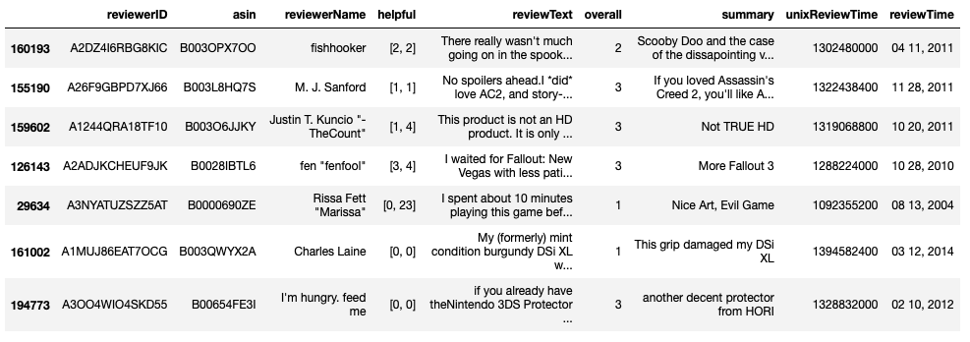
Conclusion
  Why are these reviews misclassified?

Slide 24
References

Slide 25
Stone, Philip J., Dexter C. Dunphy, and Marshall S. Smith. "The general inquirer: A computer approach to content analysis." MIT Press, Cambridge, MA (1966)
R. He, J. McAuley, Ups and downs: Modeling the visual evolution of fashion trends with one-class collaborative filtering, WWW, 2016
Kumar, Koushik; NLP: Bag of words and TF-IDF explained!, Jan 24 2021, https://koushik1102.medium.com/nlp-bag-of-words-and-tf-idf-explained-fd1f49dce7c4
Verma, Mayank, Binary Classification Using Convolution Neural Network (CNN) Model, May 8 2022, https://medium.com/@mayankverma05032001/binary-classification-using-convolution-neural-network-cnn-model-6e35cdf5bdbb

